Slide 1
Who votes?
Notes:
Pablo:
Ideally, government leaders are elected by an equal representation of the populations they serve. However, it is incredibly difficult to ensure the voter turnout equally represents the entire population. Numerous factors come into play that suppress some voices and elevate others. We want to better understand who among young Chileans are more likely to exercise their right vote. With our findings, we hope to ensure that the next generation of voters is a better embodiment of the entire population.
More specifically, we asked what is the effect of cognitive skills on political participation? What set of variables, including cognitive skills, household demographics (in particular, income) and school characteristics, are the most predictive of political participation?
The purpose of our investigation is two-fold. First, we would like to offer our insights to inform policy and make Chile a more equitable political system. Second, during the next election, we would like to share a profile of the typical young voter with the candidates we endorse to help them better target the younger generation of voters.

Slide 2
Test Scores + Voter Registration
N = 115,201
Notes:
Pablo:
We combined two datasets to better understand the younger population of voters and nonvoters. The first comes from the university admissions test (PSU), and includes not only each students’ scores, but also high school GPA, household demographics and school characteristics. We joined this data with a set that includes registered voters in 2009.
Previous research on Chilean voters typically used self-reported information to determine if someone voted. We, however, used data from voter registration, which eliminates the bias that comes with self-reported answers. At this time, voting was mandatory for anyone who registered, so we can assume that those who registered also voted.

Slide 3
Inferential + Predictive
Notes:
Jiaqing: We used both inferential and predictive models on our data. We wanted to better understand voter behavior in the past and predict the likelihood of voting based on the profile of a recent graduate. Our methods included Linear Regression, Logistic Regression, Random Forests, SVM, naive bayes, knn and LDA. It seems that our data is just not predictive enough with all of the aucs not much greater than .5. We will explain why we think this is later with the inferential results.
Our predictive methods failed. Since only 14% of the population in our data voted, our models were incredibly biased. We tried a wide range and couldn’t find one that worked, so we decided to focus on the inferential findings instead.

Slide 4
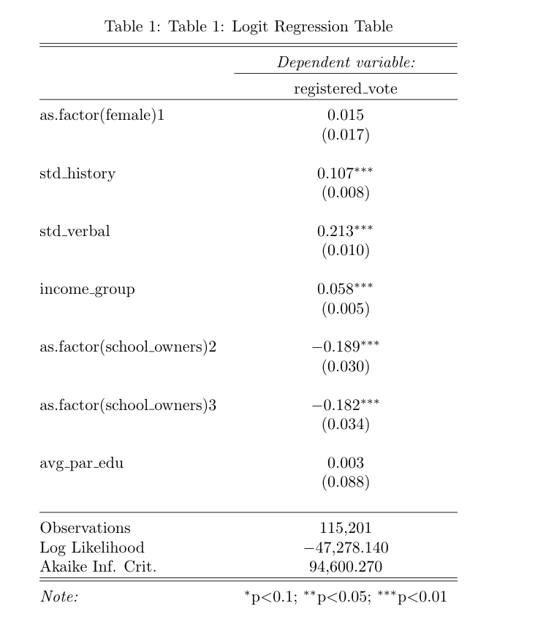
Graph here
Notes:
Jiaqing: Give a tour of this table, doesn’t need to be scripted
Ommited category school owners: private school
This is the predictive part → mention that this set of variables are the most predictive.

Slide 5
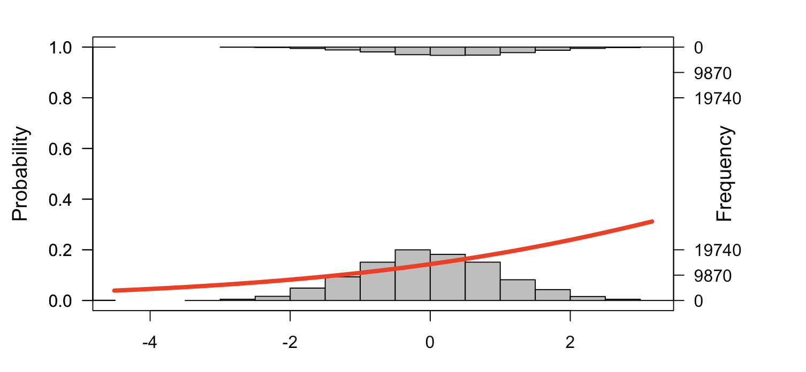
Graph here
XX - axes: income group
Y - axes: probability of registered to vote
Notes:
Jiaqing: Give a tour of this graph, doesn’t need to be scripted
And here from the three graphs we also want to explain why we think that our study is better inferential…...

Slide 6
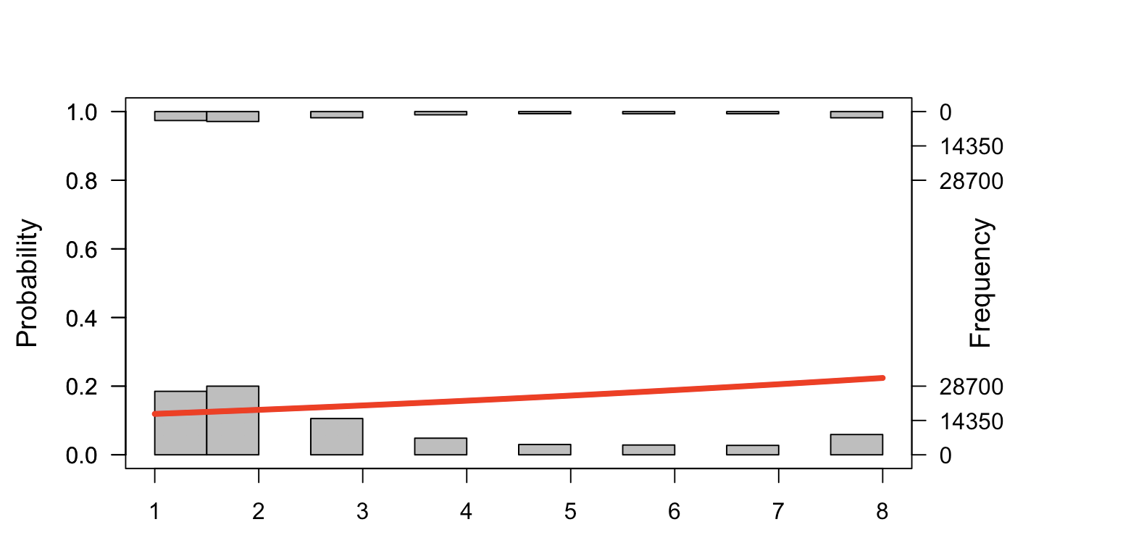
Graph here
XX - axes: income group
Y - axes: probability of registered to vote
Mean of the dependent variable = 0.14
Notes:
Jiaqing: Give a tour of this graph, doesn’t need to be scripted

Slide 7
Wealth + Knowledge
Notes:
Melissa:
We discovered that the turnout of young voters is very low, allowing us to assume that this population is generally apathetic. Consequently, the small percentage of voters made it difficult to predict who is likely to vote in future elections. We were able to find some important insights from those who did vote.
Our findings reveal the percentage of voters increased in the highest income group compared to the lowest income group. We also discovered that the higher the income, the higher the tests scores and grades, leading us to believe that wealthier students receive a better education.
Out of all the testing categories, higher verbal scores are correlated with increased voting. We can assume from our findings that increased literacy leads to increased political participation.

Slide 8
Policy:
Target disadvantaged
Notes:
Melissa:
We’ve all heard that knowledge is power. However, when demonstrated knowledge is connected to income, power is not evenly distributed. The citizens from low income backgrounds, who have more to gain from strong government programs, don’t exercise their power through voting. This is especially problematic when we’re looking at the youngest generation of voters. If no action is taken and the trends continue, political power will remain disproportionately with the wealthy and educated.
Long term, we can increase voting in low income communities by increasing literacy programs in lower income schools. If we can build a strong foundation in reading from an early age, we are likely to see more young people vote in the future.
For more immediate effects, we recommend implementing programs at schools to inform students about why it is important to vote. People can be motivated by why. If we can help young people understand a few good reasons why they should vote, as well as instruct them on how to vote, more might go to the polls for future elections.

Slide 9
Campaigns:
Target high knowledge
Notes:
Melissa:
We can also use these insights in support of candidates that we endorse. Politicians often seek to mobilize younger generations of voters. However, if their efforts are not targeted, they may be a waste of time. We can encourage them to campaign more heavily in higher income areas. We can also suggest adding more educational elements in their messaging to lower income communities to continue to promote equal empowerment.

Slide 10
Analyze Elections,
Influence Trajectory
Notes:
Melissa:
In order to support our recommendations and increase the impact of our project, we plan to pursue a few more avenues of information.
We want to better understand the profile of the likely voter and nonvoter by further exploring a few things. We plan to produce several graphs with voter registration data, income levels and test scores spatially located across Chile. We may be able to find geographic trends in the data that will allow us to focus our recommended programs in areas of need.
In addition, we can explore data from a more recent election when the mandatory voting law was lifted. We’re curious if it changed the qualities of a voter. Did more low income, less educated Chileans vote or less? What other trends are revealed in these more recent elections? What does it mean for the trajectory of voting in Chile? How can we compare the two findings? If we want to influence the trajectory of voting participation in Chile, we need to better understand the trends in participation since this election.

Slide 11
Questions?
Notes:
Jiaqing

Slide 12
Research Questions
What is the effect of cognitive skills on political participation?
What set of variables -including cognitive skills, household demographics and school characteristics, are the most predictive of political participation?

Slide 13
Research in American Politics has focused on variables such as education (Delli Carpini 2000, Berinsky \& Lenz 2011), race (Fraga 2016), electoral laws (Holbein \& Hillygus 2016), political competition (Sandell 2008), class / union membership (Leighley \& Nagler 2007), etc.
In Comparative Politics, particularly in Latin America, scholars have focused on civic networks (Carreras \& Castañeda 2014) and the interaction between age and class (Corvalán \& Cox 2013).
Typically, they have used self-reported indicators of voter turnout, such as the American National Election Studies.

Slide 14
However, scholars have usually have not been able to disentangle two different effects: education -measured through years of schooling- and cognitive skills -measured through test scores in particular subjects- (Condon 2015).
By using the National Education Longitudinal Study of 1988 (NELS), she found a positive effect of verbal skills acquired during adolescence.
Our paper: builds on this tradition of research in Political Science.
Our contributions: 1) we can also disentangle years of schooling from cognitive skills, 2) behavioral (not self-reported) measure of political participation, 3) rich set of covariates.

Slide 15
Data Source
We use two sources of data, both from Chile:
University Admission Test (PSU) for the 2008 academic year (taken in December 2007). Equivalent to the SAT in the US. Contains test scores (verbal, math and history), high school GPA, school characteristics and household demographics.
Electoral registers of the presidential election of 2009. This was the last election with mandatory voting. Thus, people in this list actively decided to vote in the 2009 election. We merged both sources by national id number. If a subject from the PSU data is in the electoral registers, it means that she / he decided to vote in the 2009 election (outcome)

Slide 16
Characteristics of the final sample
Given that is possible for people to re-take the test, there is some age variability in our sample. We decided to keep students who were born between 1988 and 1991, since older people had much more time to register to vote. With this filter, the sample size is 115,201 observations.
Among this subset of students, 14% decided to participate in the next presidential election.

Slide 17
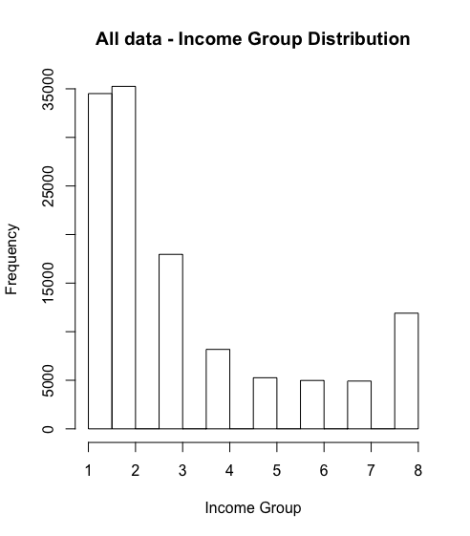

Slide 18
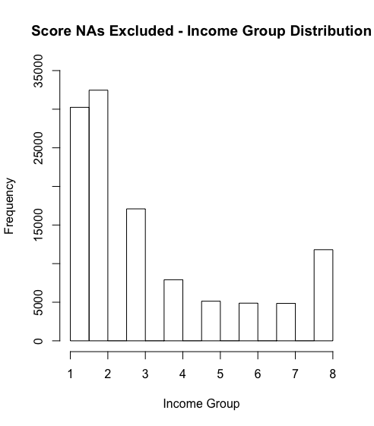

Slide 19
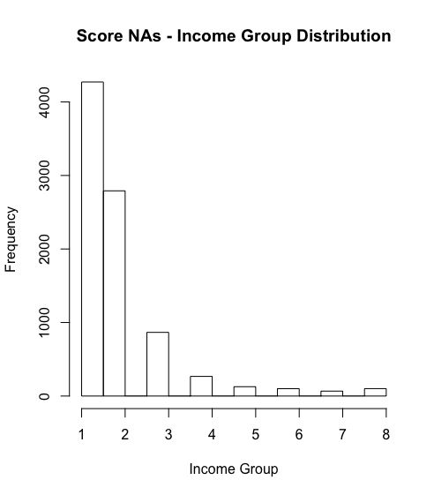

Slide 20
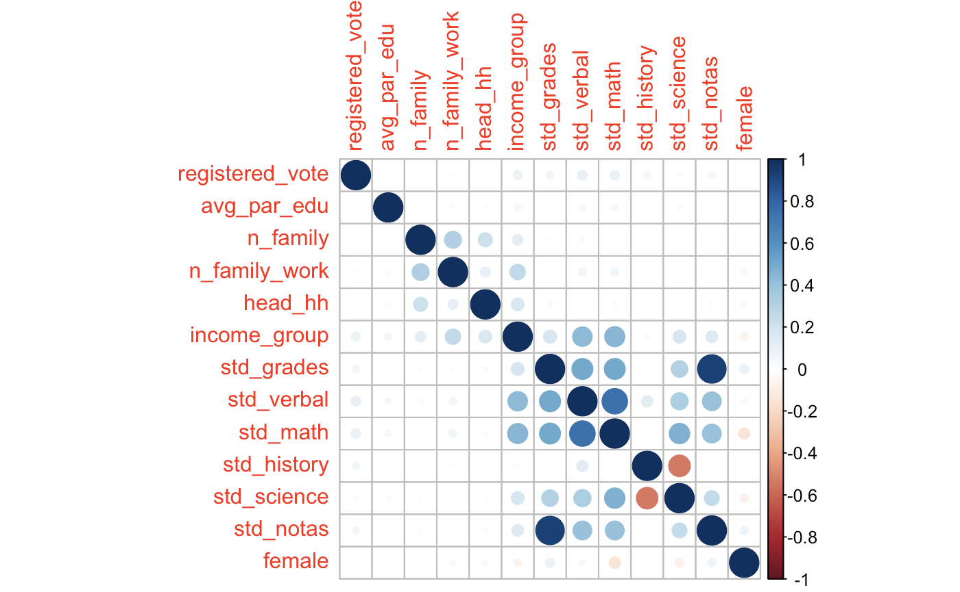

Slide 21
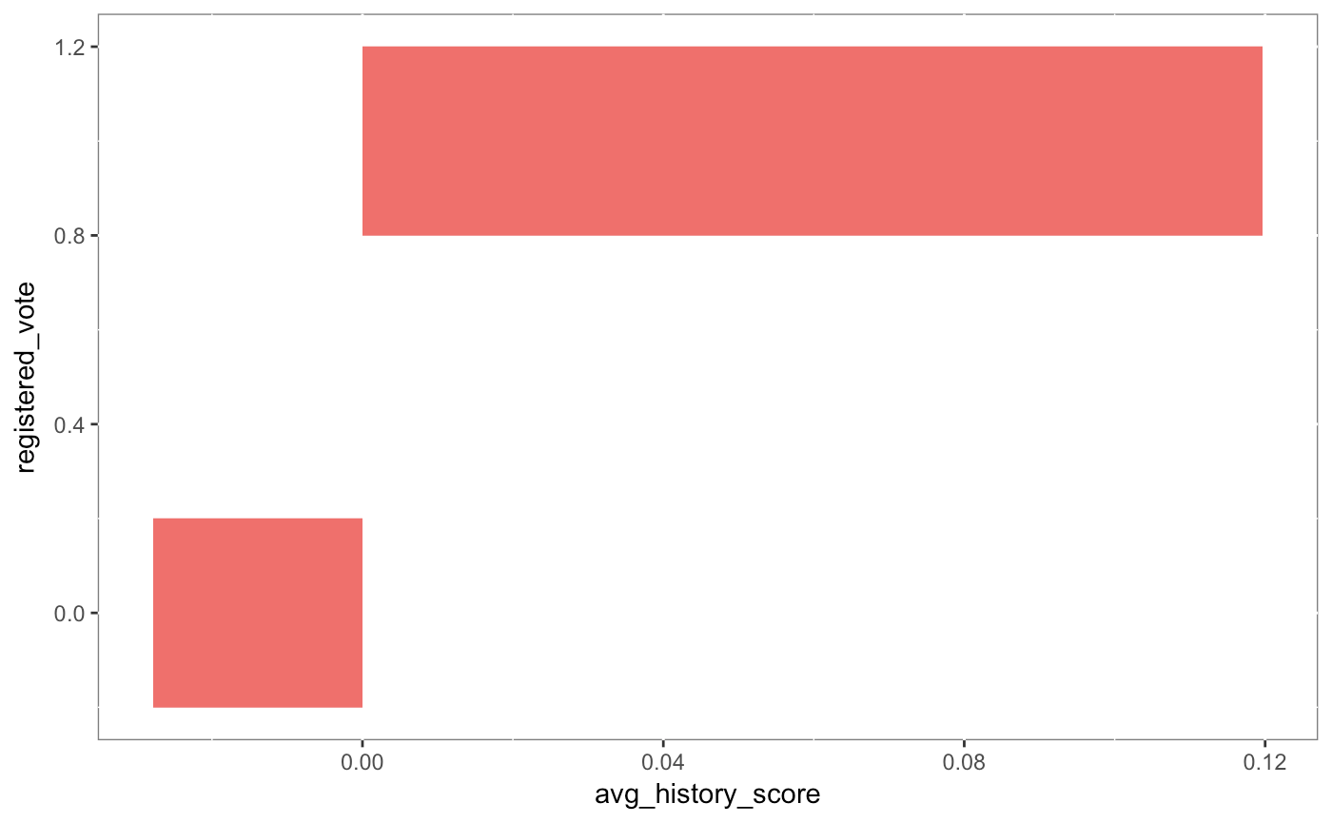

Slide 22
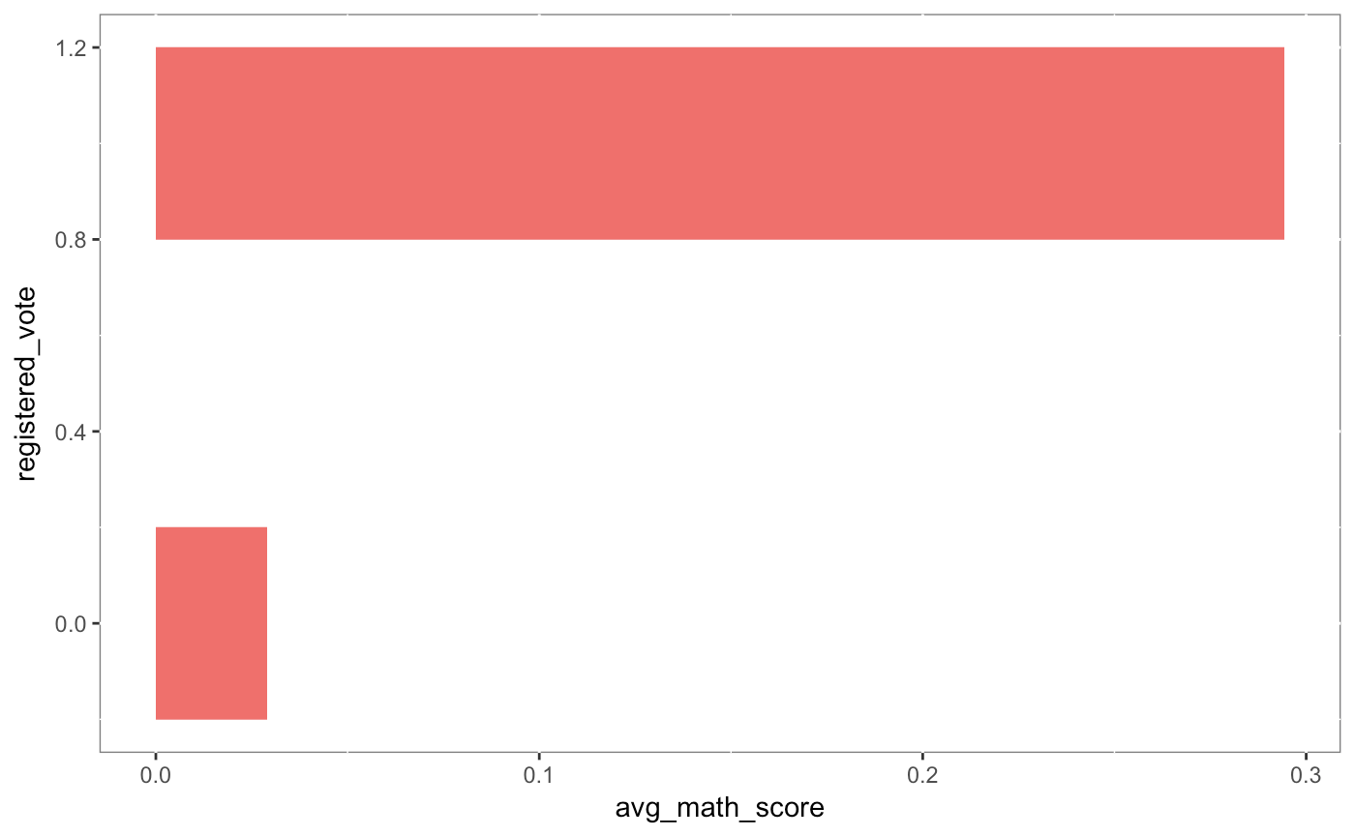

Slide 23


Slide 24
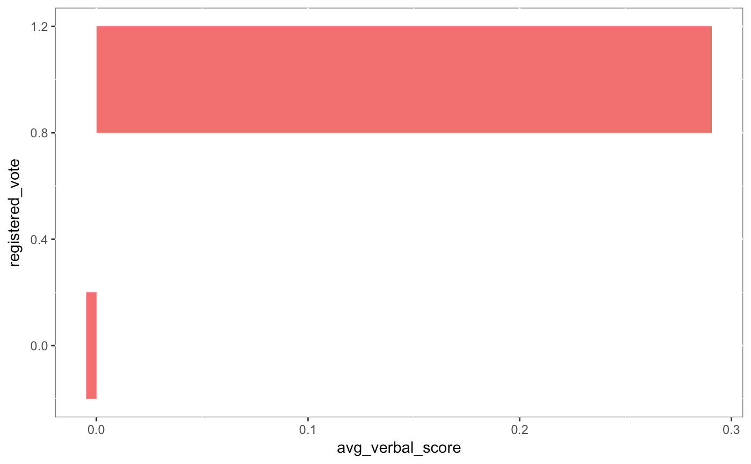

Slide 25
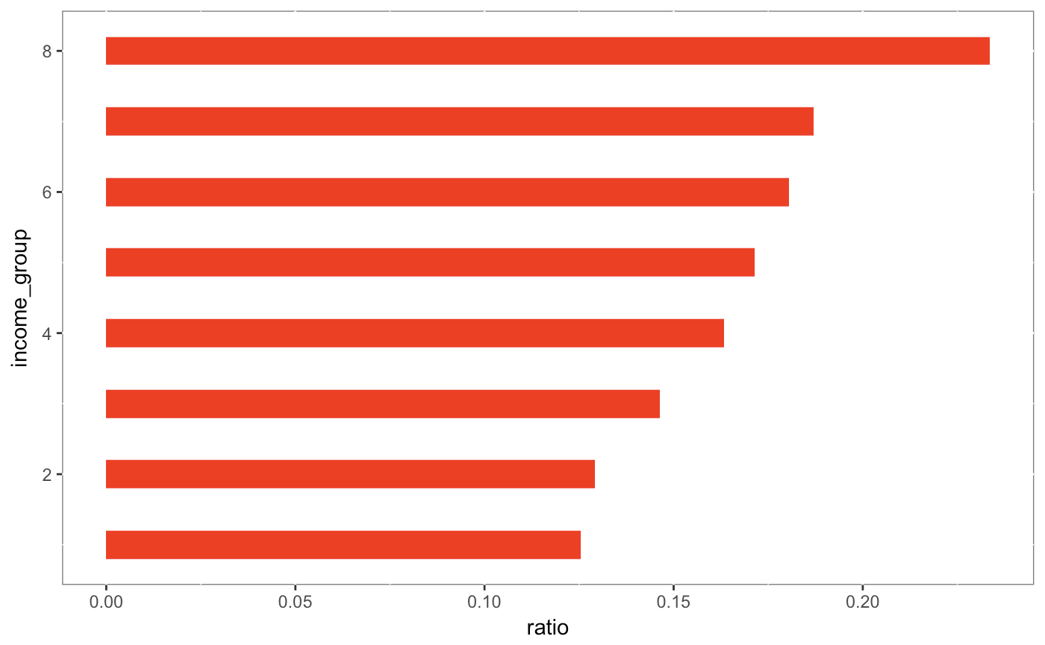

Slide 26
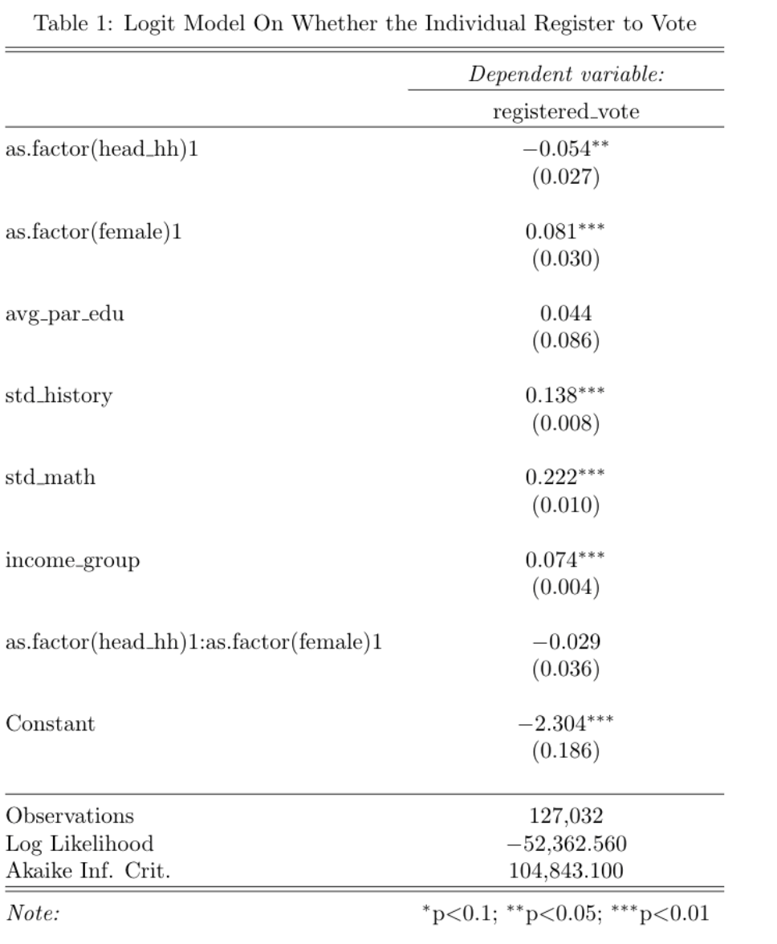

Slide 27
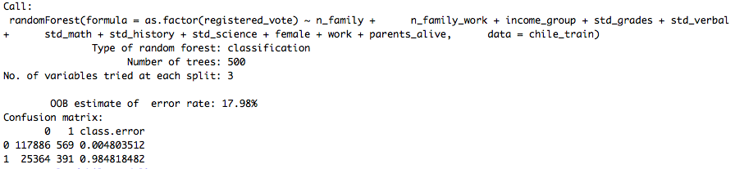

Slide 28
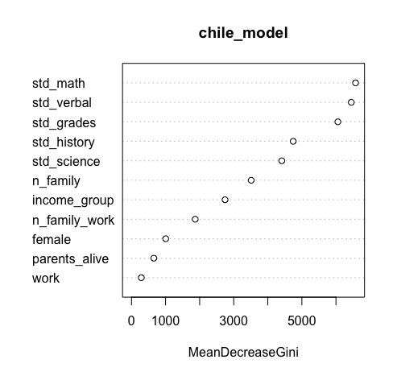

Slide 29
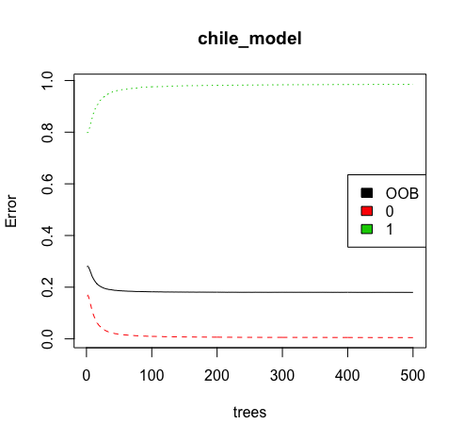

Slide 30
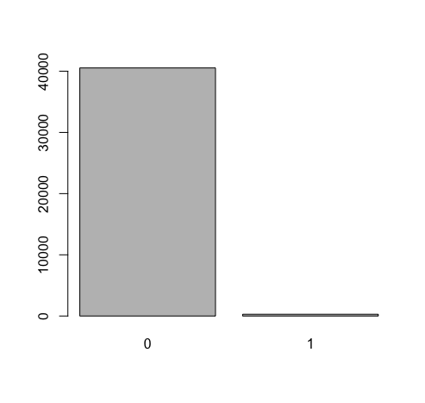

Slide 31
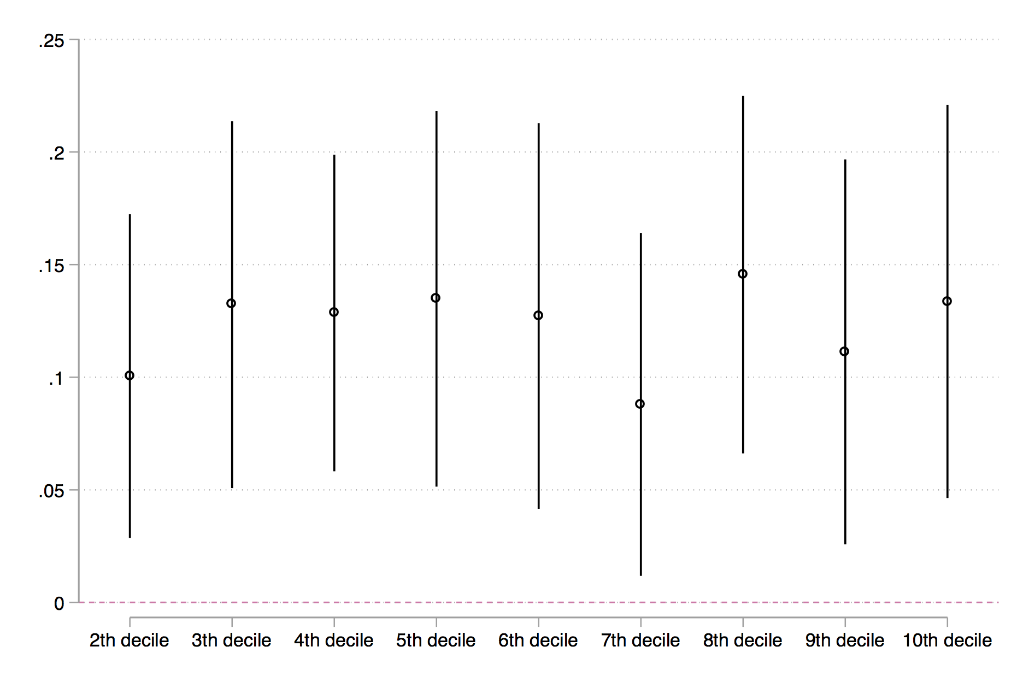

Slide 32
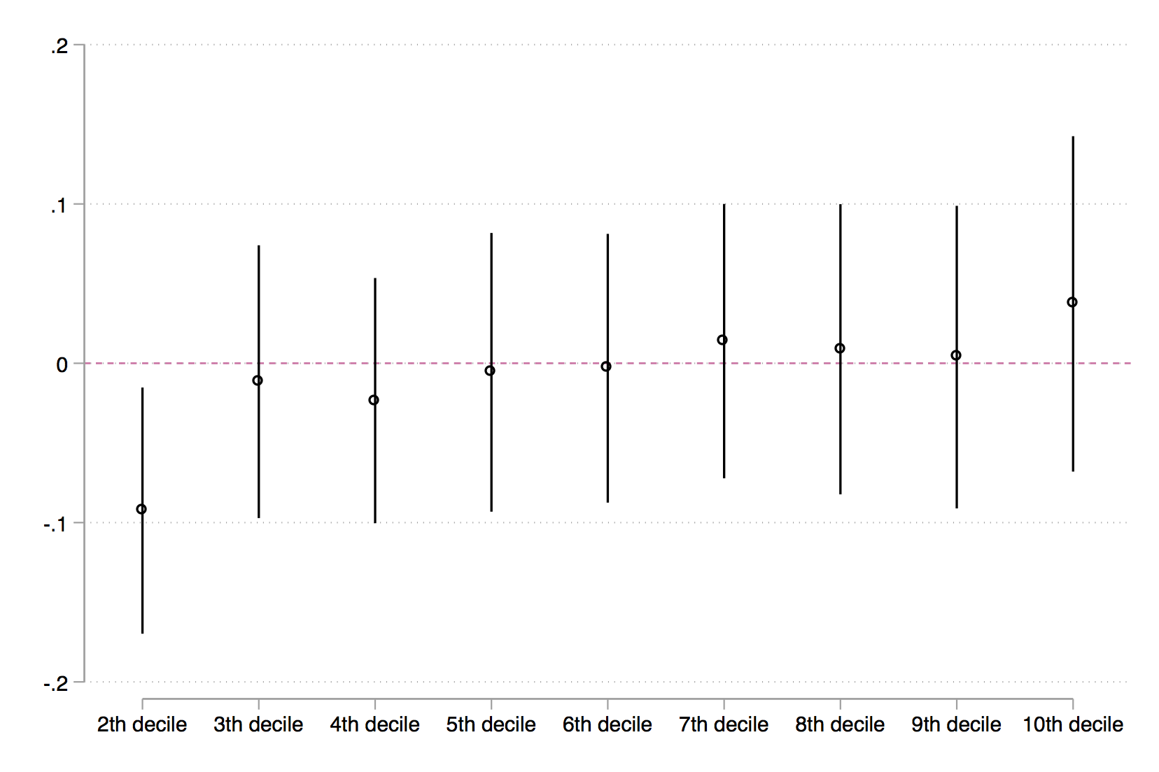

Slide 33
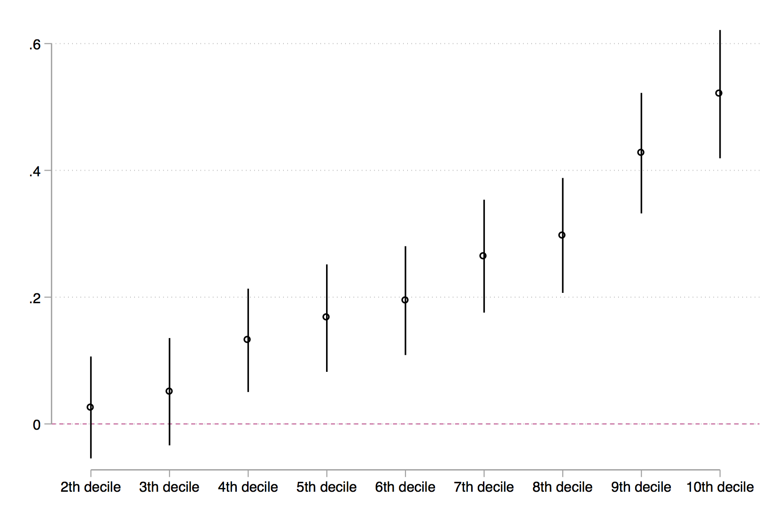

Slide 34
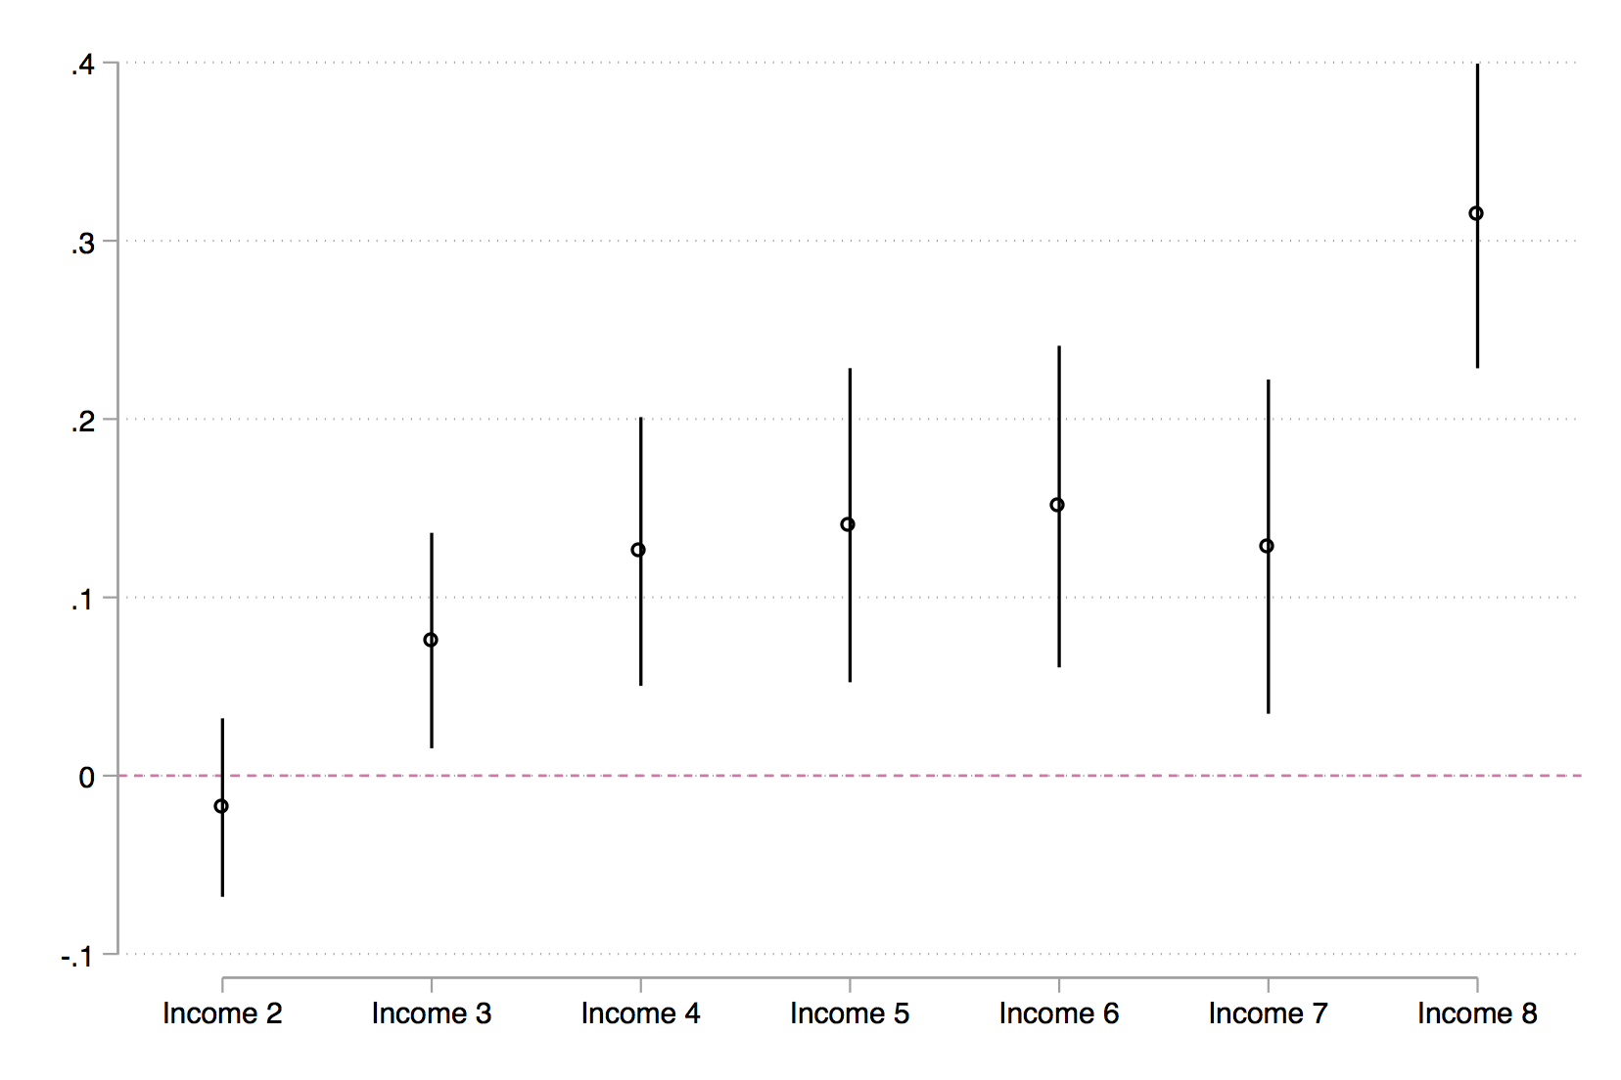

Slide 35
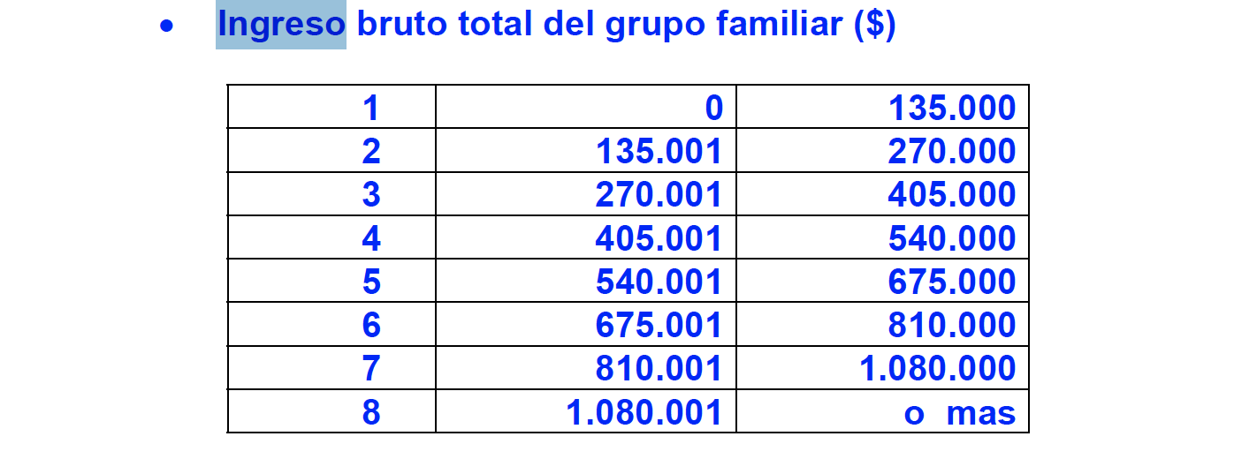
Income variable
600 chilean pesos = 1 USD

